Slide 1
Image-based Object Detection System for Self-driving Cars Application
Bin Yang

Slide 2
汇报提纲
1、introduction
2、Goal
3、Team Member
4、System Environment
5、Data Analysis and Augmentation
6、Model Structure
7、Result

Slide 3
1 introduction
Self-driving car is the exciting area, which can be interpreted a world-class Artificial Intelligence task. It includes Machine Learning, signal processing and Control Theory.
Deep Learning provide a cheaper and more reliable way for car to understand the scene better by giving better objects detectors and trackers.
In this project, we are targeting to build an image-based state-of-art object detector from scratch from a given driving data.

Slide 4
2 Goal
Detect 4 different kinds of objects in given images by training 10k annotated training images. The detection precision is measured by drawing bounding box around the objects.
Four different objects include vehicle, pedestrian, cyclist and traffic lights.

Slide 5
3 Team
Member: Bin Yang
4 System Environment
Python 3, Anaconda, numpy, Tensorboard
Windows and AWS
MXNet
Model: YOLO

Slide 6
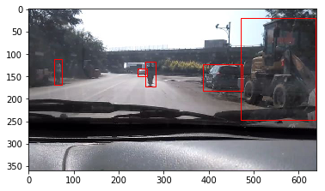
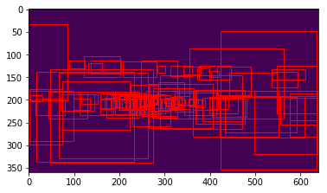
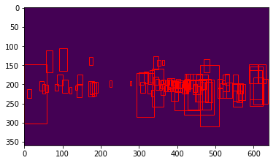
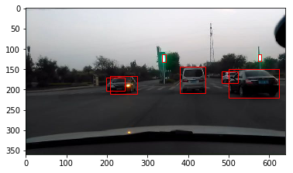
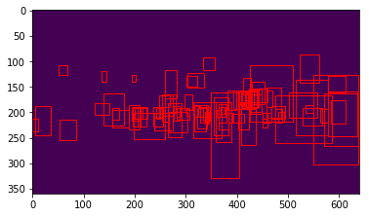
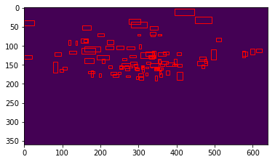
5 Data Analysis and Augmentation
Car people
motorcycles Traffic light

Slide 7
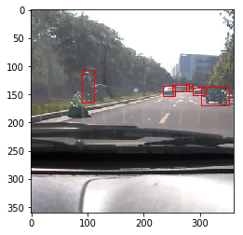
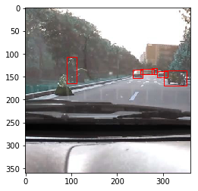
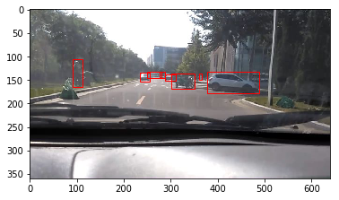
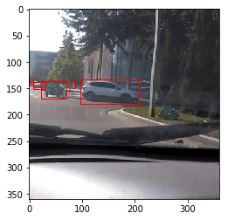
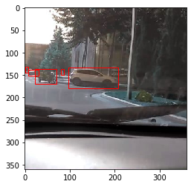
5 Data Analysis and Augmentation
Cutting
Flipping

Slide 8
5 Data Analysis and Augmentation
nums | Total images | No Bbox images | Total Bboxs
Raw data | 10,000 | 593 | 53,910
Data augmentation | 40,000 | 4,614 | 142,896
Bbox nums(%) | Vehicle | Pedestrian | Cyclist | Traffic Light
Raw data | 0.84 | 0.07 | 0.06 | 0.03
Data augmmentation | 0.85 | 0.07 | 0.05 | 0.03

Slide 9
6 Model Structure
image
Resnet-34
Conv
Out
3X224X224
512X7X7
9X7X7
Yolo V1

Slide 10
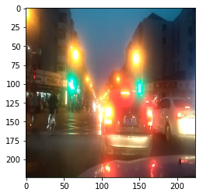
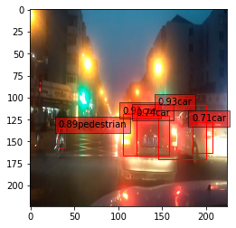
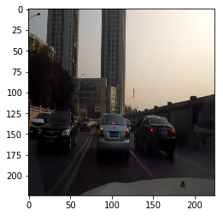
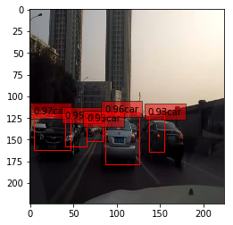
7 Result
Data Augmentation | Val_precision | Val_recall | AP
Raw data | 0.72 | 0.71
Cutting&flip(x4)
Code: https://github.com/StephenBin/AutonomousYOLO
Json file: https://github.com/StephenBin/AutonomousYOLO/blob/master/test_result.json

Slide 11
Thanks！

